Slide 1

Adarsh Samaj Sahyog Samiti
TEAM Name:-
TEAM NO ONE

Slide 2
Adarsh Samaj Sahyog Samiti is a voluntary organization registered with the government of Haryana working on an all-India basis. It is a social organization engaged in welfare activities aimed at alleviation of human suffering and the aid of the poor, helpless & weaker sections of Indian society.
What are we?

Slide 3
Our Motto
Adarsh Samaj Sahyog Samiti spreads the idea of friendship and fraternity .
It stands in support of upliftment in the status of women and rural area development.
The members of the organization also provide legal advice to poor people ,work against the dowry system, domestic violence etc.
Every child receives a good quality education, and learns the skills they will need to thrive in the 21st century through Samiti's yearly scholarship program;
Establish Mohalla clinic for health check of people.
Provide financial assistance for marriage of daughter from impoverished families.
Promote and spread Environmental awareness
Notes:
(These don’t have designer IDs since they were based off the default master slides already in the deck.

Slide 4
Why US?
We have designed a portal to attract a generous crowd for donations to carry our noble work forward.
We aim at uplifting women and betterment of the poor.
Not just monetarily, but providing voluntary support to the NGO’s and putting your skills to use
Make the donor feel secure about his donations by keeping a track and giving updates to the donor about how the money is being spent.
Notes:
(These don’t have designer IDs since they were based off the default master slides already in the deck.

Slide 5
Key Features
Service Volunteers
Tracking the donations
Collaborative Effort
Suggestions Box
Help Box

Slide 6
Service Volunteer
We want that people can not only help monetarily but by their valuable skills too.
We want to create a professional database containing information about doctors ,lawyers, teachers and people having other skills which can taught to the rural women and help them gain self employment.
Doctors can volunteer to provide free health checkups , lawyers can provide legal advice in cases like dowry and domestic abuse ,teachers can help provide education to the poor students.

Slide 7
Tracking Donations
Our motive is that whosoever is donating should be able to keep a track of their donations.
They will be able to view what work is being done or what progress is made in an initiative with their money.
This will build a trust in them that their money is being put to good work and they will be further motivated to donate more seeing the results.

Slide 8
Collaborative Effort
We will have a collaboration with institutions like different schools and colleges .
Invite them to celebrate different festivals with us and inculcate a feeling of friendship among them.
This will help instill moral values as they will share their resources with the underprivileged.

Slide 9
Help Box
You can enter your contact number with your issue we will revert to you within 24hrs .
Give you the needed monetary help or the service required.

Slide 10
Suggestion Box
We are open for suggestions if anybody wants to inform about an ongoing problem in some area we will look into the matter.
It will help you to connect to us and further connect to the concerned authorities.

Slide 11
Scalability
Digital Marketing Solutions: Through television ads and radio services.
Billboard Advertising: Billboards in regional languages can be put up at all places frequently visited by people.
Social Campaigns: Engaging and inclusive campaigns can be conducted to increase reachability.

Slide 12



Tech Stack used
HTML
CSS
BOOTSTRAP

Slide 13
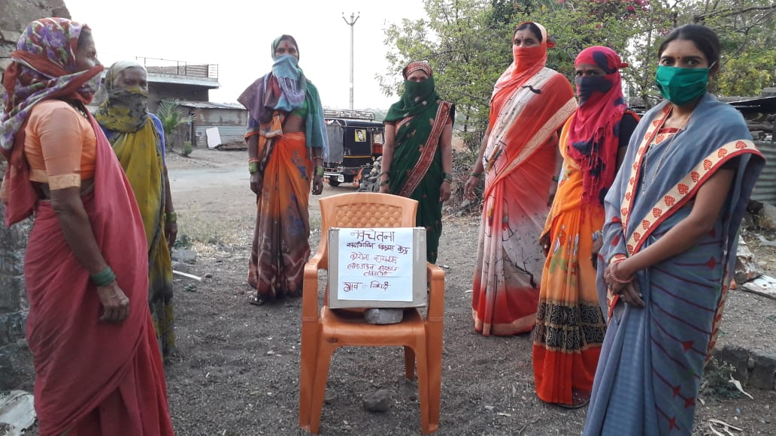
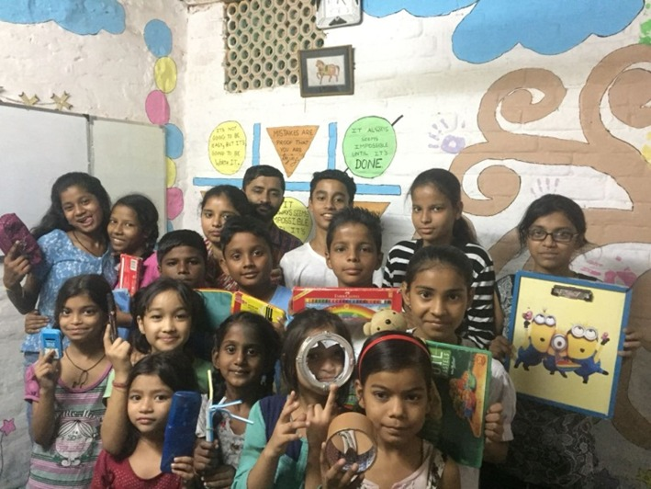
Thank You
- Team NO ONE

